Slide 1
Spring Data - JPA
Compiler: Lê Anh Vũ
Email: levu@yahoo-corp.jp

Slide 2
Agenda
JPA
JPA Architecture
JPA Entity Relationships
JPA - JPQL

Slide 3
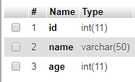
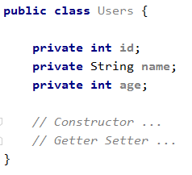
JPA
JPA is a specification standard for mapping between java and relational objects through ORM (Object Relational Mapping) technology

Slide 4
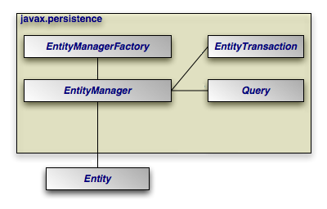
JPA Architecture

Slide 5
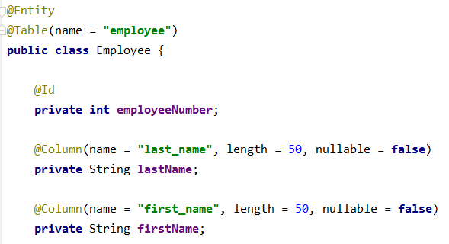
JPA Architecture
Entity: mapping with DB table

Slide 6
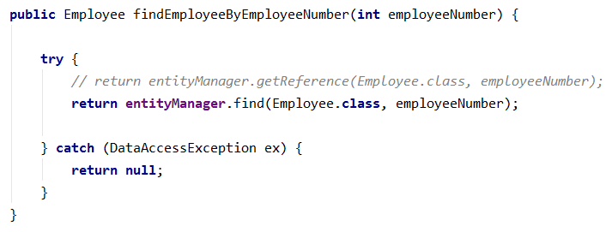
JPA Architecture
Entity Manager: an interface that provides APIs for interacting with Entities
Some Basic function of EntityManager:
Persist
Merge
Remove
Find

Slide 7
JPA Architecture
Entity Manager Factory: Create instance of Entity Manager

Slide 8
JPA Entity Relationships
Some basic relationships:
@ManyToOne
@OneToMany
@OneToOne
@ManyToMany

Slide 9
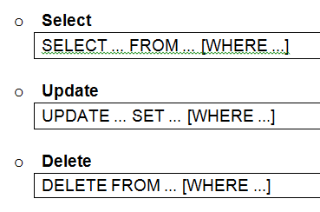
JPA - JPQL
JPQL is the query language on Object
Structure and syntax of JPQL are the same with SQL

